Slide 1

PROJECT
PRESENTATION
Presented By : Group 1 (Subgroup 1)
Department of Statistics, SUST| 2024

Slide 2
Group Members
Name
Registration Number
2018134042
2018134051
2018134097
2018134119
2017134046
Md Abir
Md Emanur Rahman
Md Moshiur Islam
Syed Irfanul Huda
Ahmed Al Asif

Slide 3
1
PROJECT TITLE
Exploring The Lifestyle of Street Children
In Bangladesh
Department of Statistics, SUST | 2024

Slide 4
2
OVERVIEW
Introduction
Methodology
Objectives
Result & Discussion
Literature Review
Conclusion
Department of Statistics, SUST| 2024

Slide 5
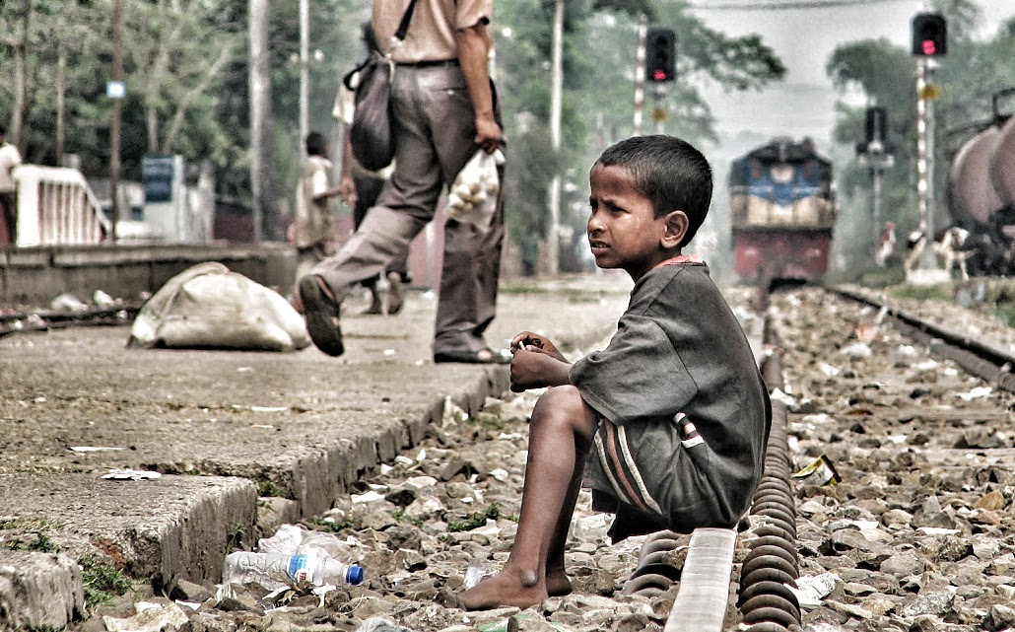
3
INTRODUCTION
Who are Street Children?
Street children are defined as those for whom the street has become their habitual abode and source of livelihood. Poverty, family dysfunction, abuse, social exclusion, and lack of educational access are among the drivers that lead children to the streets.
Department of Statistics, SUST| 2024

Slide 6
4
INTRODUCTION
Background of the Study :
Street children face complex challenges, leaving them vulnerable and underserved. Existing research has focused on physical health, but there is a need for a holistic understanding of their lives. This research seeks to fill these gaps, shedding light on their experiences and advocating for improvements.
Department of Statistics, SUST| 2024

Slide 7
5
OBJECTIVES
Objective 1
Objective 2
Objective 3
To explore the lifestyle of street children in Bangladesh
To find the association among various factors related to street children.
To compare what factors are affecting most on attending school of street children
Department of Statistics, SUST| 2024

Slide 8
6
INTRODUCTION
Rationale of the Study :
This study aimed to address critical knowledge gaps on the daily lives and experiences of street children in Bangladesh. Prior research has often focused narrowly on singular issues like health or education, without capturing the multifaceted realities these children face. Small qualitative studies dominate, limiting generalizability. The voices and perspectives of street children themselves are also frequently excluded
Department of Statistics, SUST| 2024

Slide 9
7
INTRODUCTION
Scope of the Study :
The scope focused on Bangladeshi street children surveyed in the 2003 Baseline Study by the Bangladesh Bureau of Statistics. Key aspects examined were demographics, work, access to food and shelter, organizational awareness, and school attendance. By investigating drivers of inclusion and exclusion through modeling school attendance odds, this study provides insights to inform targeted policies and interventions upholding street children's rights
Department of Statistics, SUST| 2024

Slide 10
8
LITERATURE REVIEW
Objectives of Previous Studies
To provide a comprehensive overview of the street children.
To explore the reasons for coming to the street of children.
To investigate the characteristics of anti-oppressive organizational structures in street youth shelters.
To explore the relationship between children's work and their well-being.
To investigate and understand the lived experiences of street children.
Department of Statistics, SUST| 2024

Slide 11
9
LITERATURE REVIEW
Methods were used in existing researches :
1. Qualitative Analysis.
2. Association Analysis.
3. Descriptive Analysis.
Department of Statistics, SUST| 2024

Slide 12
10
LITERATURE REVIEW
Data collections Techniques Were Used On The
Existing Research:
1. Surveys/Questionnaires .method.
2. Interviews method.
3. Document Analysis.
4. Focus Group Discussions.
5. Case Studies.
6. Participatory Action Research (PAR).
Department of Statistics, SUST| 2024

Slide 13
11
LITERATURE REVIEW
Research Gaps:
1. Limited Large-Scale and Longitudinal Studies.
2. Focus on Physical Health Over Psychological and Emotional Dimensions.
3. Insufficient Research on Mental Health Interventions:
4. Challenges in Education Access and Inclusion.
5. Research about the lack of responsibility and characteristics of organizations.
Department of Statistics, SUST| 2024

Slide 14
12
METHOD0LOGY
Study
Design
Dependent Variable
Independent Variable
Statistical Analysis
School Attendance among Street Children
Age
Division
Awarness
Working Hour
Eating Location
Descriptive
Chi Square Test
Logistic Regression
Cross-Sectional Study using Secondary Data
Department of Statistics, SUST| 2024

Slide 15
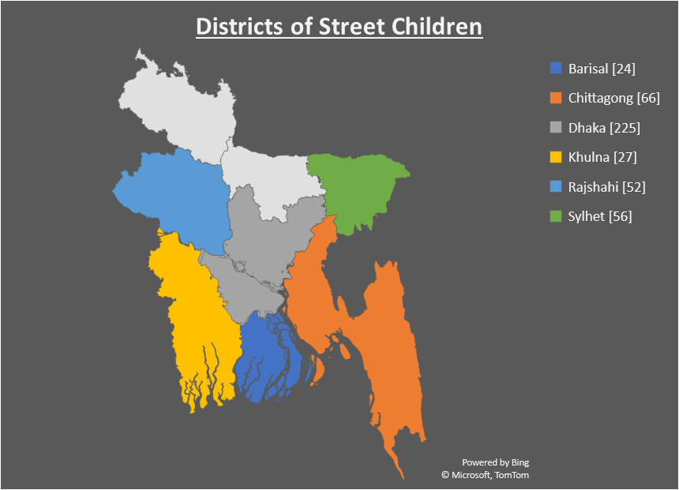
13
﻿RESULT
Total Paricipants : 450
Highest : Dhaka [225]
Lowest : Barisal [24]

Slide 16
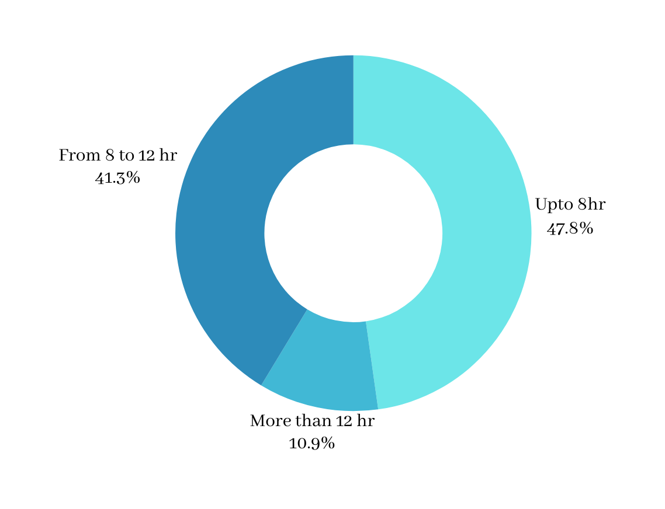
14
﻿RESULT
Figure : Working Hour
90% of Total Children work less than 12 hours a day.

Slide 17
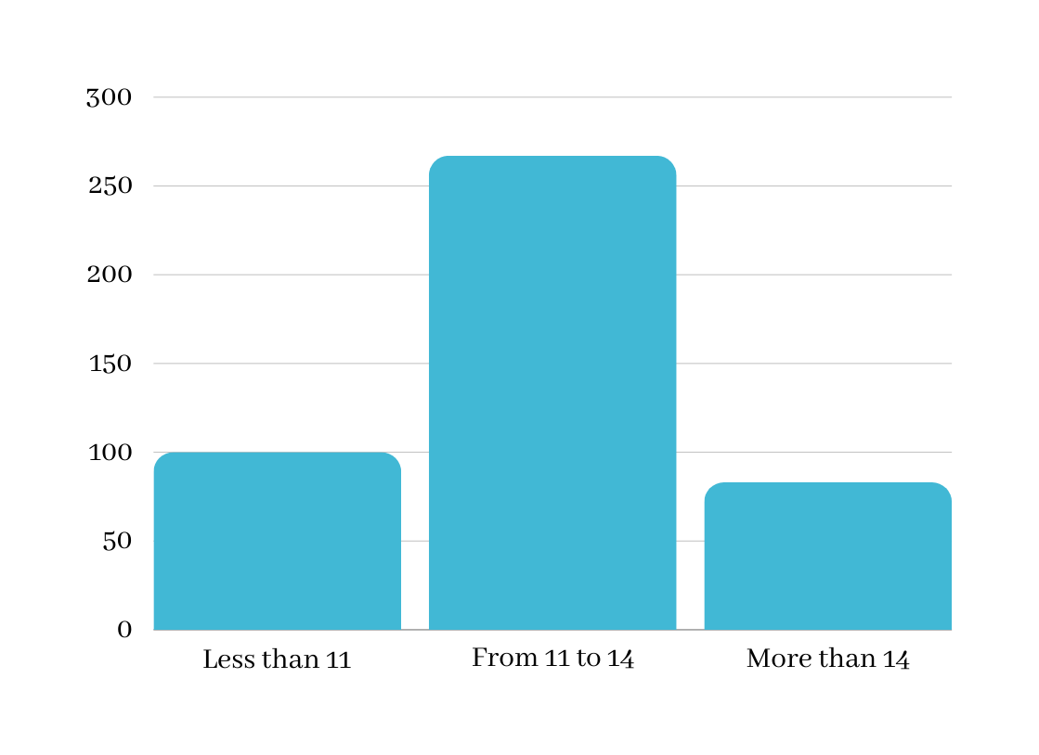
15
﻿RESULT
Figure : Age Category
Almost 60% of Total Children are 11 to 14 years old.

Slide 18
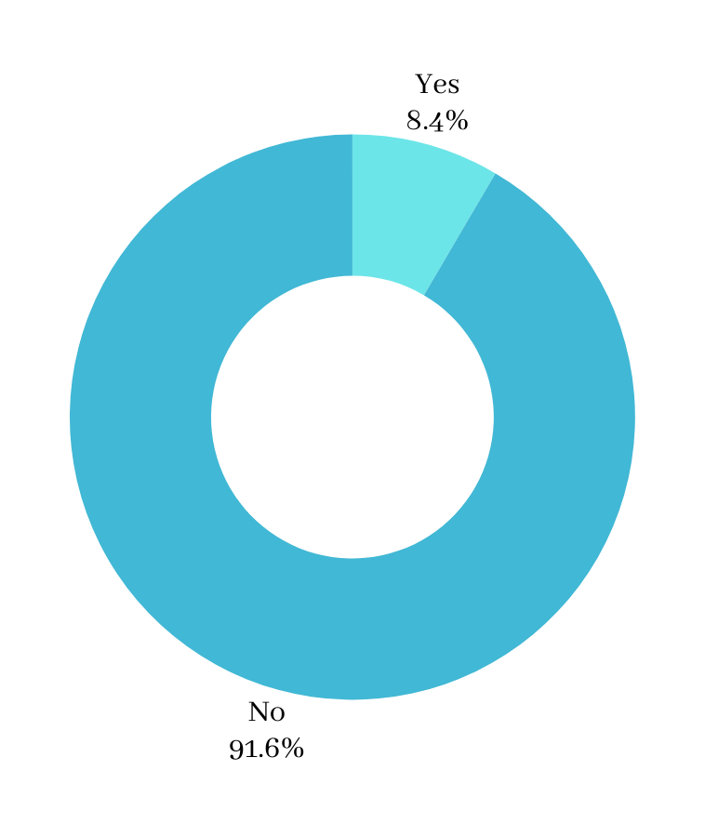
16
﻿RESULT
Figure : Aware of Organization
90% of Total Children are unaware of organizations.

Slide 19
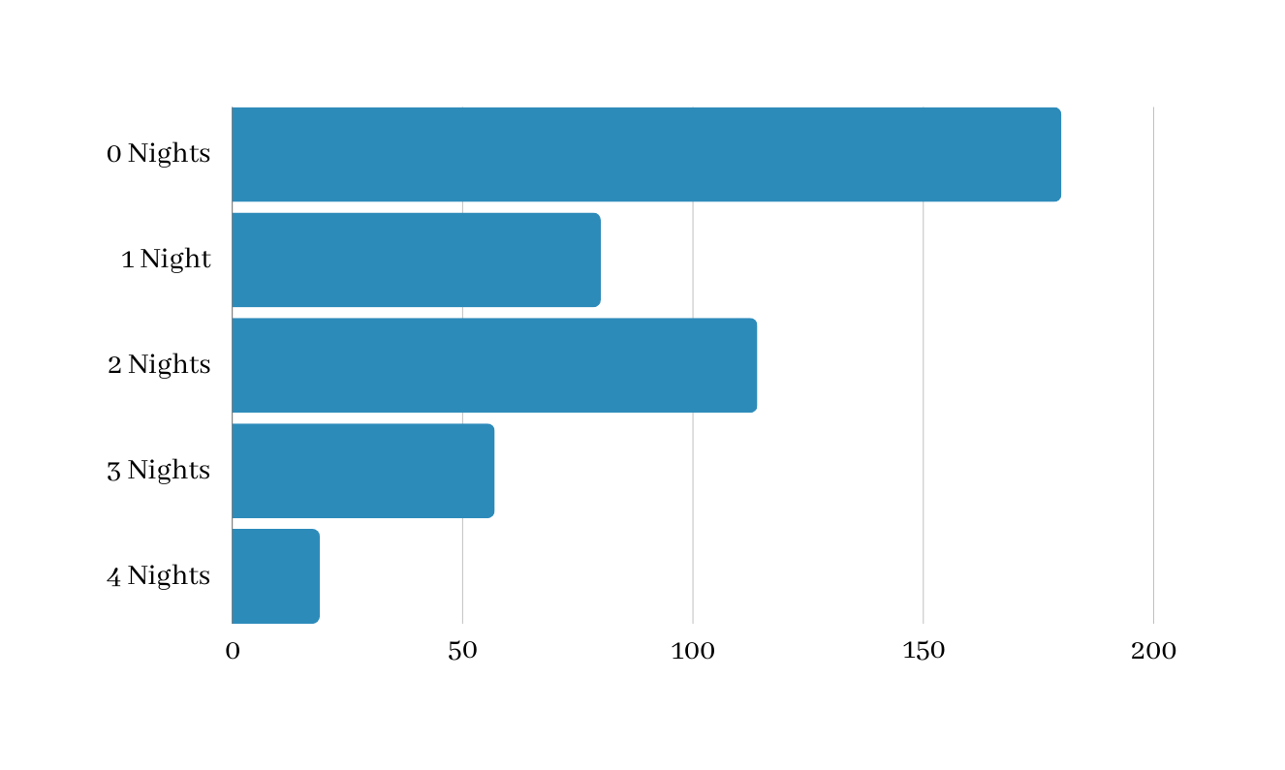
17
﻿RESULT
Figure : Nights spend Without food

Slide 20
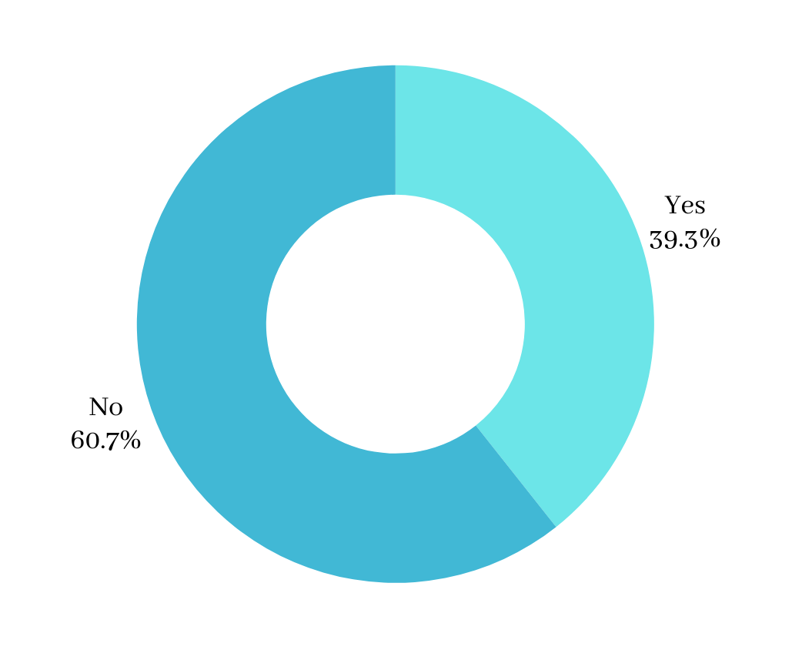
18
﻿RESULT
Figure : Attending School
40% of total street children attended school.

Slide 21
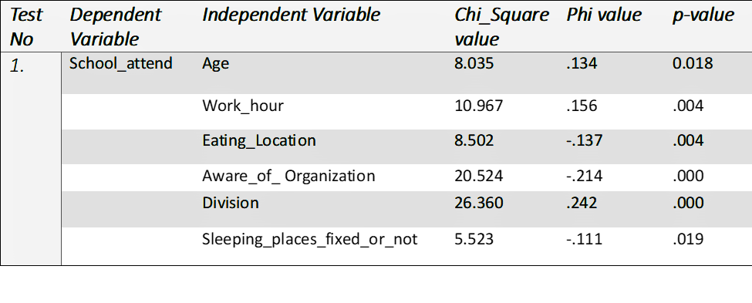
19
﻿RESULT
Table 1: Association between School_attend and other variables
p-value <.05 means association exist
Department of Statistics, SUST| 2024

Slide 22
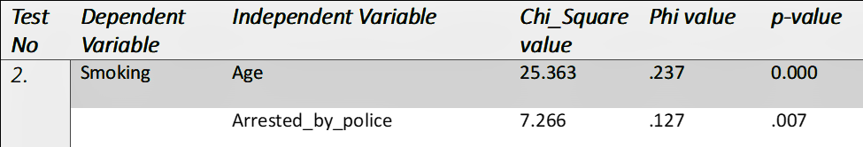
20
﻿RESULT
Table 2: Association between Smoking and other variables
p-value <.05 means association exist
Department of Statistics, SUST| 2024

Slide 23
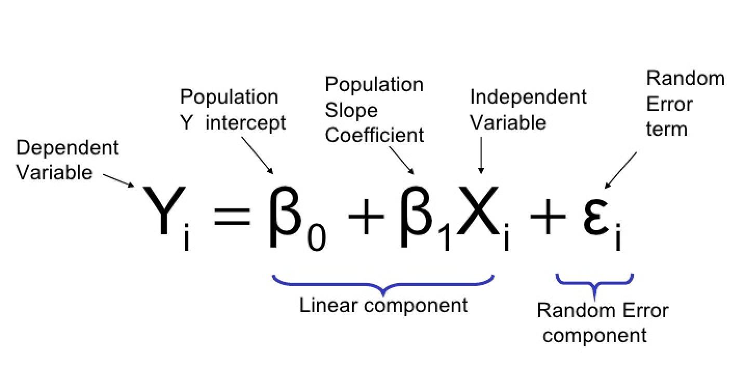
MODEL FITTING
21
Regression Model
Department of Statistics, SUST| 2024

Slide 24
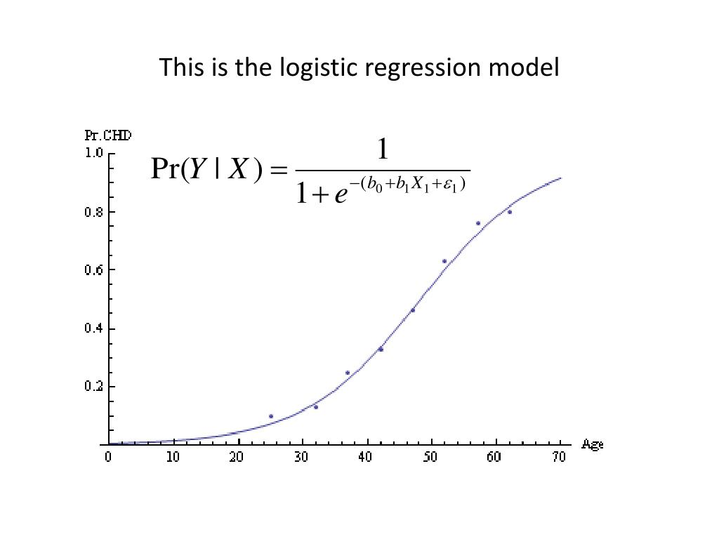
22
MODEL FITTING
Logistic Regression
Outcome Dichotomous.
Logit Link Function.
Produce log odds.
Department of Statistics, SUST| 2024

Slide 25
23
MODEL FITTING
Assumption Checking
Data Collection
Model Fitting
Tools Used :
Python 3.8
Jupyter Notebook
Excel
Data Cleaning
Data Pre-processing
Department of Statistics, SUST| 2024

Slide 26
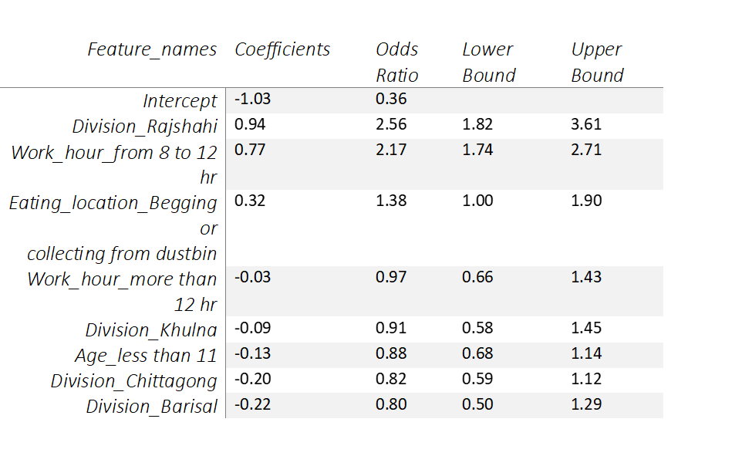
24
﻿MODEL FITTING
OR > 1 means more likely
OR = 1 means no effect
OR < 1 means less likely
Department of Statistics, SUST| 2024

Slide 27
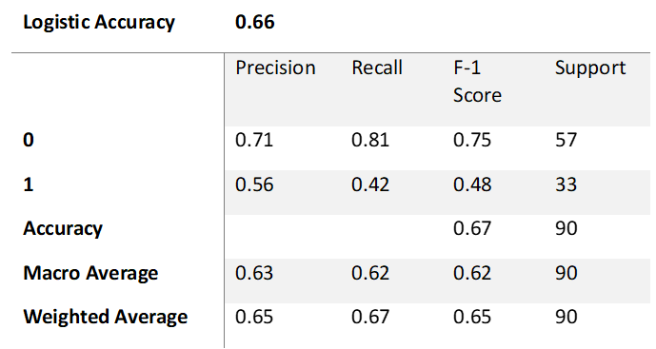
25
MODEL EVALUATION
0 = No
1 =Yes
Department of Statistics, SUST| 2024

Slide 28
26
DISCUSSION
Understanding Street Children's Challenges
Introduction to our study focusing on children living on the streets in Bangladesh.
Discussing the various problems these children face, such as not having a stable home, inadequate food, and limited awareness of organizations that can help them.
Department of Statistics, SUST| 2024

Slide 29
27
DISCUSSION
Factors Influencing Education Access
Sharing insights gained from studying 470 street children in Bangladesh.
Explaining that some older children who work a lot have difficulty attending school, while younger children and those who work fewer hours tend to do better in terms of attendance.
Department of Statistics, SUST| 2024

Slide 30
28
DISCUSSION
Addressing Barriers and Promoting Wellbeing
Geographic variations in attendance, emphasizing the need for region-specific interventions.
Importance of nutrition and health support programs in improving education outcomes.
The critical role of awareness, outreach, and rights education in accessing institutional support.
Recommendations for policymakers: specialized local interventions, collaborative research, and involving street children in co-designing interventions.
Larana University | 2024

Slide 31
29
CONCLUCION
Objectives
Methods
Results
Summary
Department of Statistics, SUST| 2024

Slide 32

Department of Statistics, SUST| 2024

